Slide 1
How We Can Help You
The purpose of this In-Service is to inform you of exactly how Care Placement can benefit you and your patients.

Slide 2
Our Role
Care Placement will…
Do a full assessment of Patient’s social, financial and care needs
Explain funding - Medi-Cal/Medicare, VA Aid & Attendance, ALW, PACE, etc.
Explain options and provide elder care resources
Provide a list of 3-5, pre-qualified, licensed Residential Care Facilities for the Elderly (RCFE)
Guide the family through the process of choosing an RCFE
Coordinate with Patient and/or Family and RCFE Administrators
Confirm and review required documentation
Follow through after placement to ensure quality of care

Slide 3
We Know The Providers
We visit the homes and communities, sample the food and rate them internally
We closely track feedback from our clients
Close monitoring of the state licensing page for citations
Homes with records of poor care or neglect are not referred to
All staff are certified RCFE administrators
Largest Local Referral Agency
Assisted approximately 30,000 families since 2000

Slide 4
Less Hospital Readmissions
Placement into care homes that are appropriately staffed with training and experience to provide the necessary level of care for each patient, means fewer hospital readmissions.
CDSS requires all homes to do an assessment prior to accepting a patient, to ensure they are able to meet their needs.

Slide 5
Immediate Discharge
Able to assist with discharge into appropriate care homes in a matter of hours
Staff is on call during nights and weekends to help whenever needed
We keep in constant contact with the care home and family, to ensure a smooth transition
We follow up with family within 2, 7 and 14 days after placement to ensure quality of care and appropriate placement

Slide 6
Funding Options
RCFE’s are primarily PRIVATELY FUNDED by the Patient
(Not covered by Medicare or Medi-Cal)
Long-term Care Insurance
Supplemental Security Income (SSI/SSP)
Veteran’s Aid and Attendance Pension Benefit
Family supplementing care costs
Reverse Mortgage, Secured Lines of Credit
Assisted Living Waiver Program (ALW) through Medi-Cal – Currently, this program has a 1-2 year waiting list to apply.
PACE Program through Medi-Cal
*Care Placement does not advise on any legal, financial, or funded programs such as Medi-Cal or Medicare. We recommend clients speak with a licensed professional for help in determining which financial option is best for them.

Slide 7
San Diego Pricing Updates
RCFE RANGE OF COST
Lease Expensive placement (past 2 years) - $2800
High End Average - $7500
Average Monthly Rate (long term) - $5628
Monthly Hospice Rates - $3500 - $6000
Average Respite Rate $200/day – Most require a 30 day minimum
Most Admission Fees in Board and Cares are now common, ranging from $500 - $2000
IN HOME CARE RATES
Hourly Rate | Hours | Amount
$30/hour | 24 Hour Staff | $21,600
 | 8 Hours/day | $240/day or $7200/mo
$35/hour | 24 Hour Staff | $25,200
 | 8 Hours/day | $280/day or $8400/mo
*Care Placement does not advise on any legal, financial, or funded programs such as Medi-Cal or Medicare. We recommend clients speak with a licensed professional for help in determining which financial option is best for them.

Slide 8
VA Aid & Attendance
2022 VA Aid & Attendance Rates:
Veteran - $2050
Surviving Spouse - $1317
Married Veteran - $2431
Veteran Couple - $3253
What are the basic qualifying factors?
Honorable Discharge
Active duty with at least 1 day during wartime period
65 yrs old+, or Permanent and total disability
Common Disqualifiers:
Dishonorable Discharge
Did not serve during the outlined wartime periods
Income exceeds the set limits
Divorced the Veteran (surviving spouses)
Not married to the Veteran during their service (surviving spouses)
*Care Placement does not advise on any legal, financial, or funded programs such as Medi-Cal or Medicare. We recommend clients speak with a licensed professional for help in determining which financial option is best for them.

Slide 9
Assisted Living Waiver (ALW)
How soon can I get someone out of the hospital?
As of March 2022, the state opened up 7,000 more slots for the ALW program.
Prioritization is for those in a medical setting, the goal is to keep people out of SNFs when possible.
If the patient has been in a medical setting for at least 24 hours, is already on Medi-Cal (no share of cost) and has an income of no more than $1,500 it is possible to place within 3-4 weeks (based on home availability).
If coming from home or an RCFE, the wait time is 1-2 years just to apply.
Once the 7,000 slots are taken, the wait time will be back to 1-2 years.
As of April 2022, there are 7,891 people on the waiting list for the ALW program.
An average of 72 people are placed into an RCFE each month on the ALW program.
*Care Placement does not advise on any legal, financial, or funded programs such as Medi-Cal or Medicare. We recommend clients speak with a licensed professional for help in determining which financial option is best for them.

Slide 10
Assisted Living Waiver (ALW)
ALW RATES
Resident is responsible for paying their own Room & Board (ranging from $1,059.37 - $1,099.37/mo)
Monthly ALW Reimbursement Rates:
Tier 1: $2,520 (Supervision)
Tier 2: $3,030 (Limited Assistance)
Tier 3: $3,450 (Extensive Assistance)
Tier 4: $3,990 (Total Dependence)
Tier 5: $6,000 (Traumatic Brain Injury)
PRIVATE PAY RATES
Averages:
Long-Term Placement - $5,800
Hospice - $6,000
Lowest Placement in 2022 - $2,395
Highest Placement in 2022 - $13,050
ALW PAY
Tier 3 Rate w/SS = $4549
Tier 4 Rate w/SS = $5089
PRIVATE PAY
Tier 3 equivalent = $5200
Tier 4 equivalent= $5800
VS.
*Care Placement does not advise on any legal, financial, or funded programs such as Medi-Cal or Medicare. We recommend clients speak with a licensed professional for help in determining which financial option is best for them.

Slide 11
PACE Program
Must be on Medi-Cal and enrolled on the PACE program.
PACE uses specifically contracted RCFEs for placement
RCFEs receive funds from PACE within 2-3 months of the patient’s move into the home
4 Board & Care Administrators (some with multiple locations), and 10 Assisted Living/Memory Care Communities are currently accepting PACE residents (through St. Paul’s PACE)
Social Security paid to the home towards Room & Board, PACE supplements the difference
Average total cost into a Board & Care is $4800 for shared, and $5500 for private. Private rooms are only arranged if absolutely necessary, otherwise they place into shared rooms at the lower rate.
If a patient does not yet qualify for Medi-Cal and needs to spend down funds, RCFE’s will accept them as private pay and assist with the right resources to apply for Medi-Cal and enroll with PACE. The home will want assurance that they’ll qualify for Medi-Cal once the funds are exhausted.
*Care Placement does not advise on any legal, financial, or funded programs such as Medi-Cal or Medicare. We recommend clients speak with a licensed professional for help in determining which financial option is best for them.

Slide 12
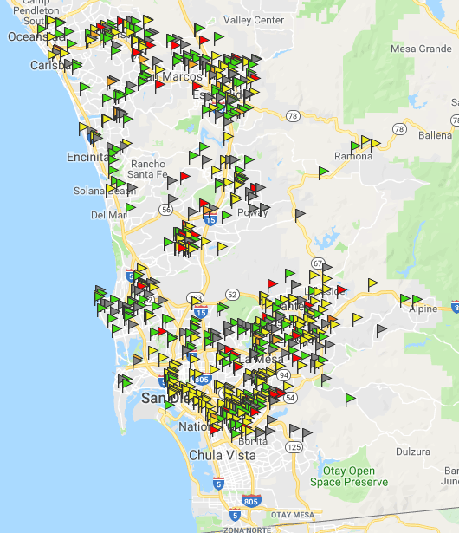
San Diego RCFEs
21,408 RCFE beds
579 facilities
458 Board & Care Homes
121 Assisted Living/Memory Care Facilities
916 Hospice Waivers (estimated)
Avg. Hospice Rate = $6000/mo
Avg. Long Term Rate = $5628/mo
(as of 4/22)

Slide 13
BOARD & CARE

Slide 14
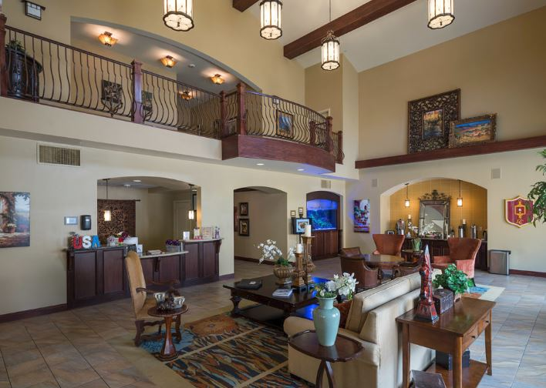
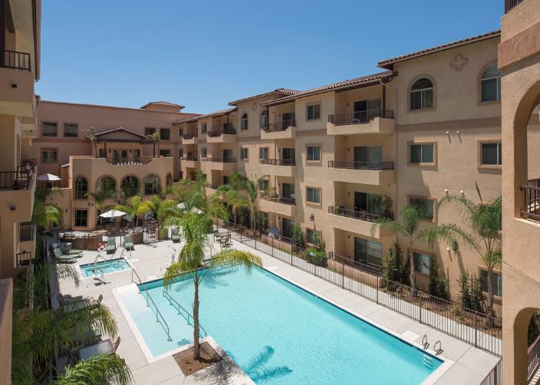
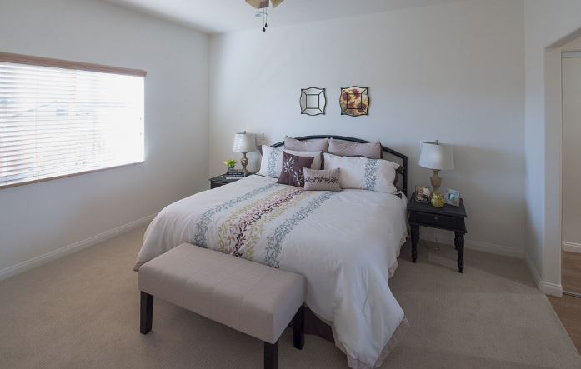
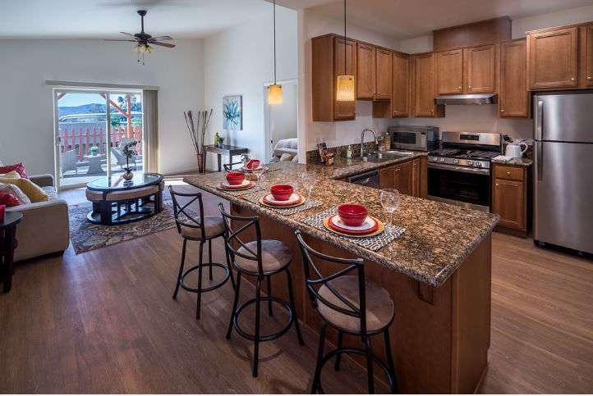
ASSISTED LIVING

Slide 15
Kaiser Web Portal
www.careplacement.com/kaiser
Web Portal Features
Independent Living list of available rooms in San Diego County
Board & Care (RFCE) Readmission Checklist
Assisted Living Waiver (ALW) Pre-screen Form
6 Page Physician’s Report download (Required prior to placement into any RCFE)

