Slide 1
RCFE Educational In-Service
The purpose of this In-Service is to provide information on Residential Care Facilities for the Elderly (RCFE). RCFE’s include Board & Care, Assisted Living, and Alzheimer’s / Dementia Communities (also known as Memory Care).
The State of California regulates RCFE’s with Allowances, Restrictions, and Prohibited Conditions, which means that not every patient is appropriate for placement into an RCFE. All RCFE’s are not appropriate for every patient due to their differing needs. We will review those Conditions with you, to help you to know what patients are appropriate for placement.

Slide 2
What is an RCFE?
Residential Care Facilities for the Elderly (RCFE) are non-medical facilities that provide around-the-clock care and supervision to residents, ages 60 and above, who need help with activities of daily living (ADL’s).
Activities of Daily Living (ADL’s) - Bathing, dressing, grooming, ambulation, toileting, incontinence, medication management, transportation, meals, laundry, housekeeping, etc.
Amenities – Some RCFE’s offer daily activities, outings, allow for personal pets, can arrange for short-term respite stays, provide furnishings, have religious services, etc.
Specialized Services – Only some RCFE’s can provide care for: Wander Risks, Exit-Seekers, Sundowner’s, Catheters, Ostomies, Two-Person Transfers / Hoyer Lift, Bariatric, Insulin Injections, Special Diets, Bedridden, Feeding Tubes, Hospice, etc.

Slide 3
What types of RCFE’s are available?
Residential Care Facilities - Also known as “Board and Care”. 1-15 beds. Staff Ratio of 2-3 caregivers to 6 residents.
Assisted Living Communities - 16+ beds. Staff Ratio of 1 caregiver to 10-15 residents.
Alzheimer’s/Dementia Care - Also known as “Memory Care”. Behaviors must be stabilized. Secured for wanderers and some exit seeking.
Specialty Alzheimer’s/Dementia Care - For those with behaviors, or those who need a secured environment for severe exit seeking.

Slide 4
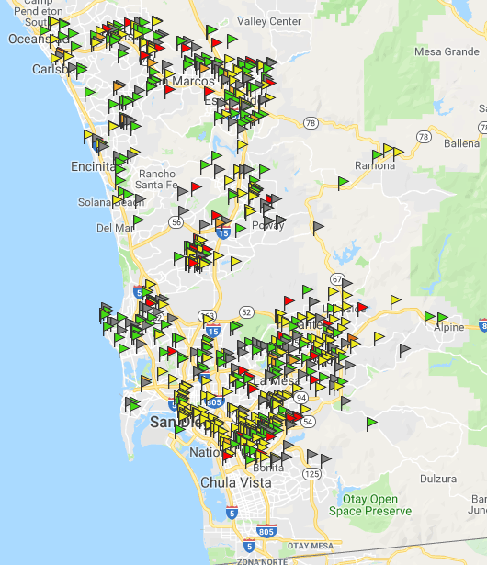
San Diego RCFEs
19,610 RCFE beds in 588 facilities
12,511 Assisted Living beds (119)
2,834 Board & Care beds (458)
1,195 beds in 21 RCFEs Pending Licensure
5,505 Alzheimer's/MC beds in 57 facilities
399 RCFEs have Hospice Waivers (59%)
Avg. Hospice Rate = $120
(as of 1/1/19)

Slide 5
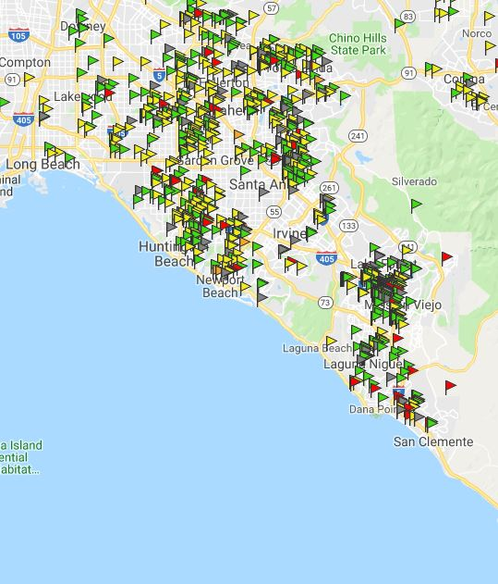
Orange County RCFEs
20,447 RCFE beds
in 947 facilities
12,076 Assisted Living beds (95)
5,031 Board & Care beds (841)
5,422 Alzheimer's/MC beds in 51 facilities
5,368 Assisted Living MC beds (42)
54 Board & Care MC beds (9)
614 RCFEs have Hospice Waivers (66%)
Approx. 65 Hospice Beds Now Available in 55 RCFEs
Avg. Hospice Rate = $120
(as of 1/1/19)

Slide 6
Our Mobile Database App
Homes Database - With nearly 2,000 homes in San Diego and Orange County, we track all licensed RCFE’s and regularly check Community Care Licensing to keep up-to-date on all pending locations, as well as those that have closed, or changed ownership. We also monitor their Complaints and Deficiencies with licensing so that we know which homes are having neglect issues, and which homes have a clean standing with licensing.
Mobile App - At the patient’s bedside, we are able to help families locate care homes in their preferred area. The app has pictures of each RCFE as well as notes from our personal visits, and family testimonials.

Slide 7
Title 22 Restricted Health Conditions
The following are allowed if self-managed by the resident OR administered by an Appropriately Skilled Professional, such as, a Registered Nurse:
Oxygen (Gas / Liquid)
Catheter (staff can only empty the bag of it’s contents)
Colostomy/Ileostomy (staff can only empty the bag of it’s contents)
Fecal Impaction Removal, Enemas and/or Suppositories
Contractures
Injections
Intermittent Positive Pressure Breathing (IPPB) Machine
Stage 1 & 2 Pressures Sores

Slide 8
Title 22 Prohibited Health Conditions
New Allowances in RCFE, some with Restrictions
Stage 3 & 4 Pressure Sores (Prohibited, unless on Hospice)
Communicable Infections – Staph, CDIFF, MRSA, etc. (Prohibited, unless colonized)
G-Tube, PEG, NG-Tube, IV’s (Some allowances on Hospice, or if in a home with 24-hour Nursing)
Bedridden (Requires Fire Clearance)
Wound VAC
Psych/Mental Illness as a primary diagnosis (Must not have any behaviors that would disturb other residents.)

Slide 9
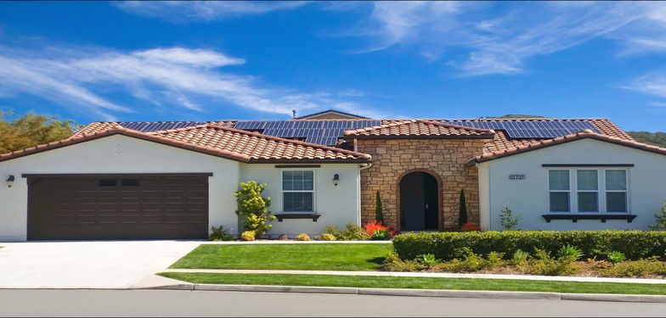
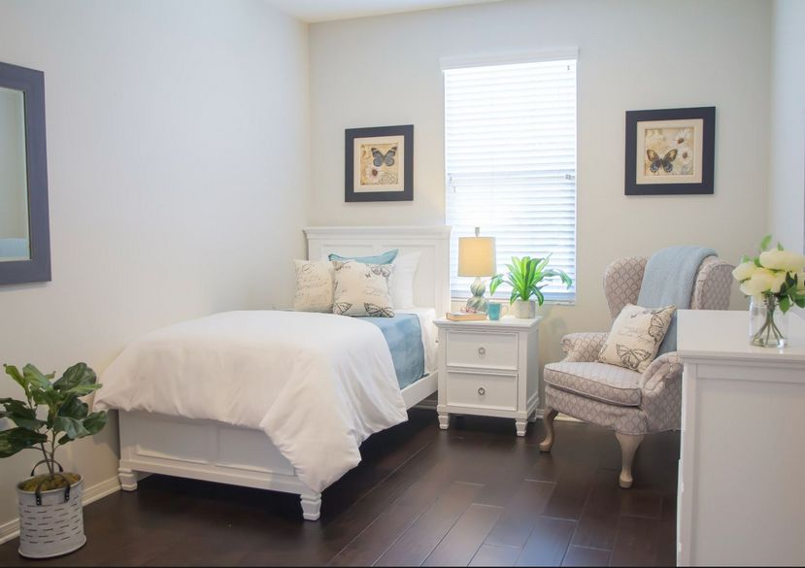
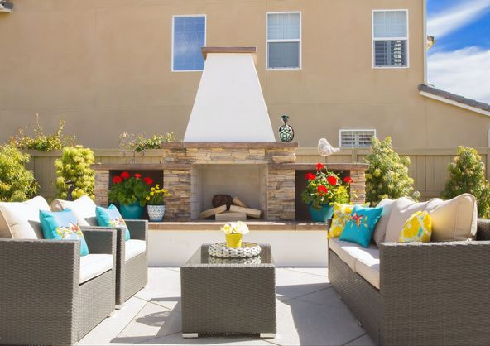
Residential Care Home
High End
Private rooms from $5500 Shared rooms from $4500

Slide 10
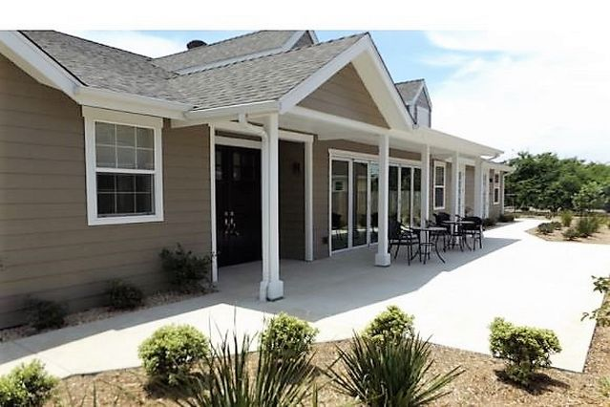
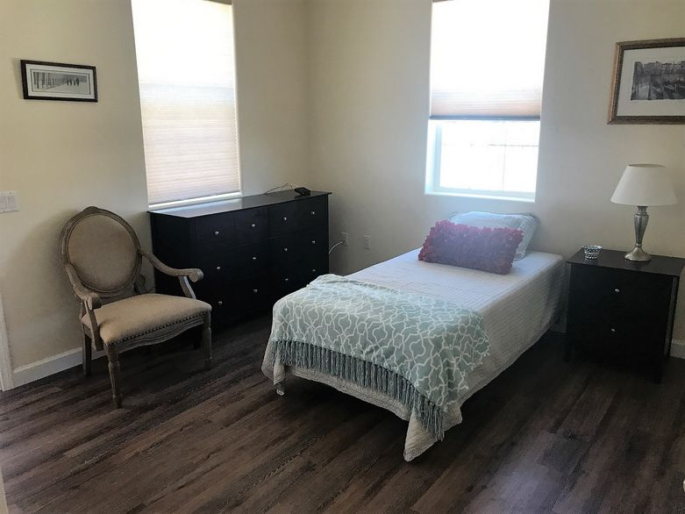
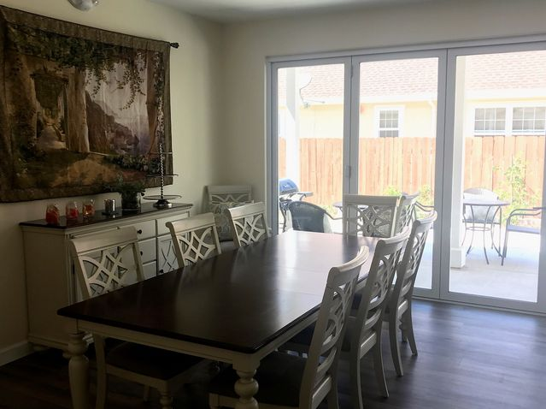
Residential Care Home
High End
Private rooms from $5500 Shared rooms from $4500

Slide 11
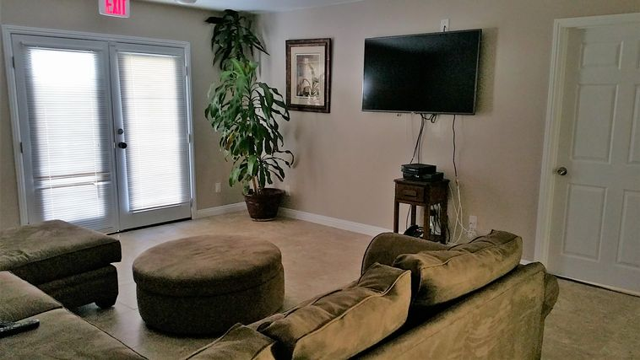
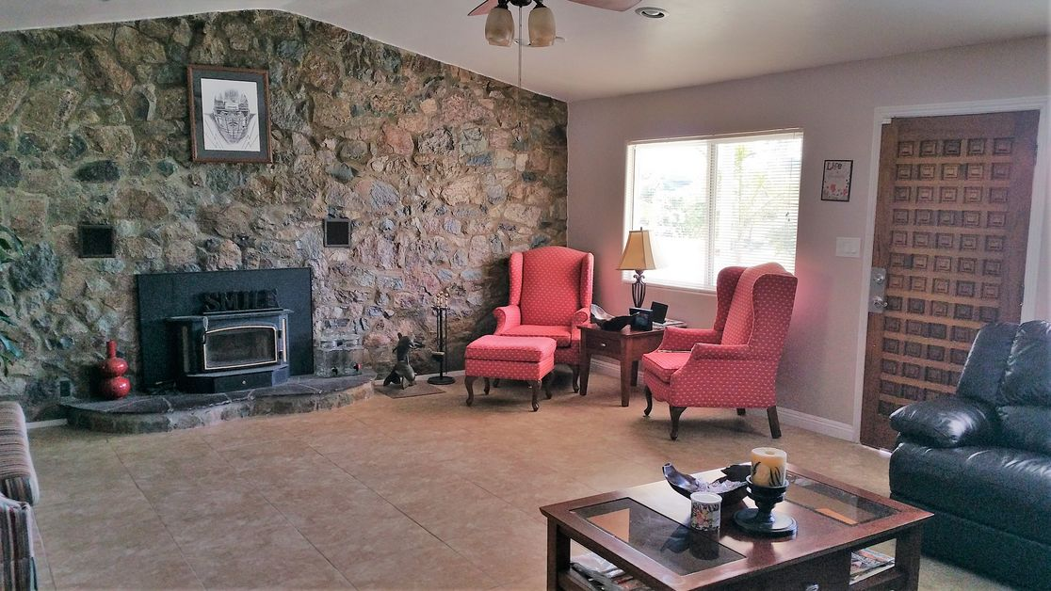
Residential Care Home
Moderately Priced
Private Rooms from $4500
Shared Rooms from $3500

Slide 12
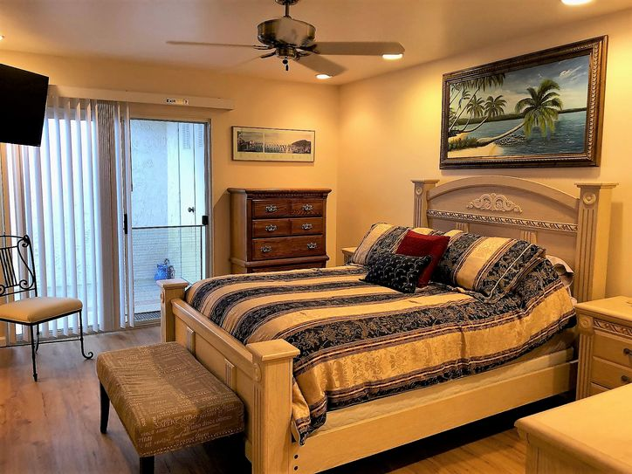
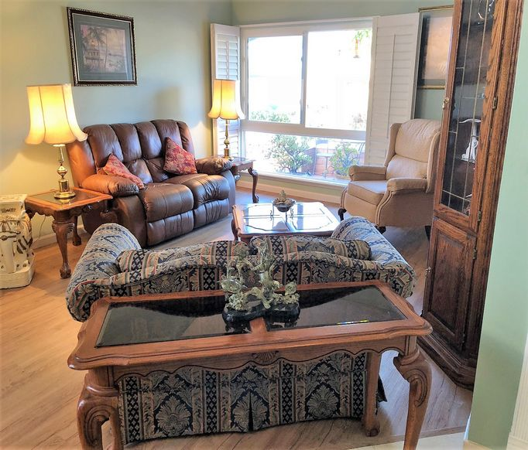
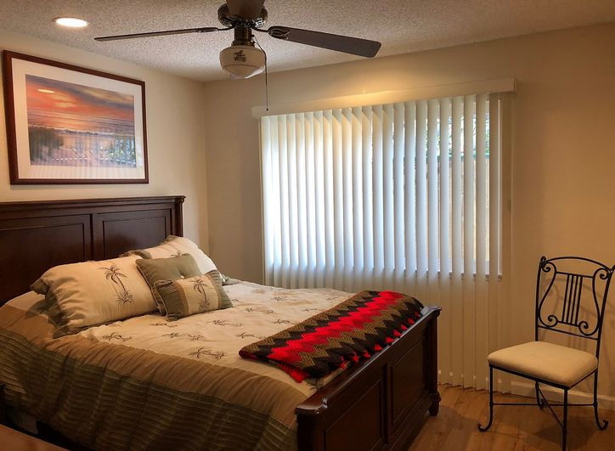
Residential Care Home
Moderately Priced
Private Rooms from $4500
Shared Rooms from $3500

Slide 13
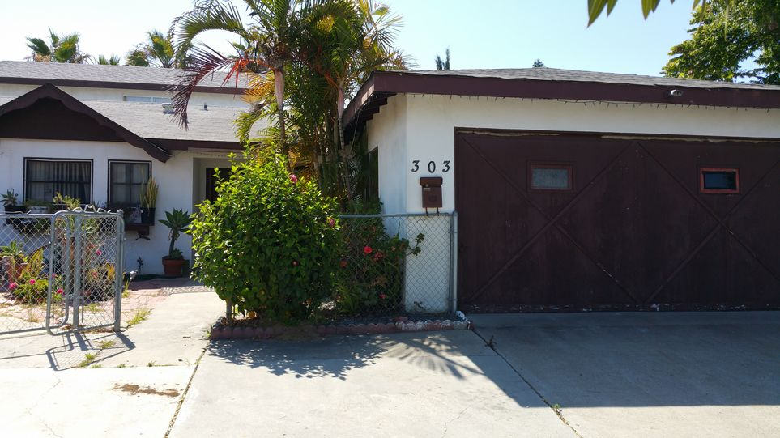
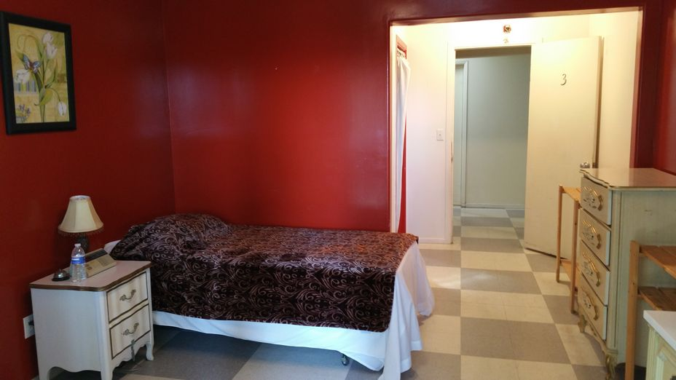
Residential Care Home
Low Cost
Private rooms from $2500 - $3000
Shared rooms from $1600

Slide 14
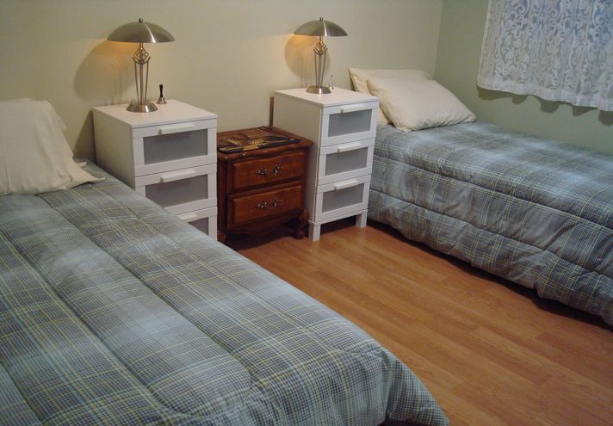
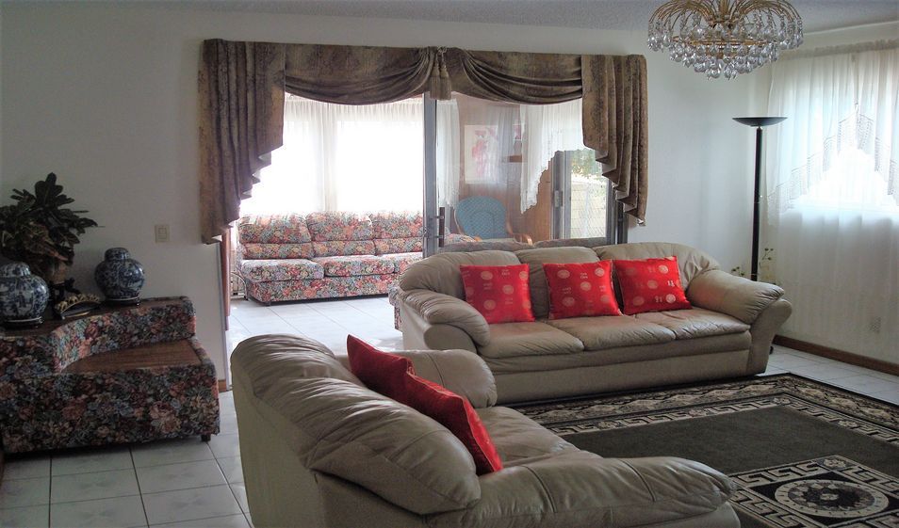
Residential Care Home
Low Cost
Private rooms from
$2500 - $3000
Shared rooms from $1600

Slide 15
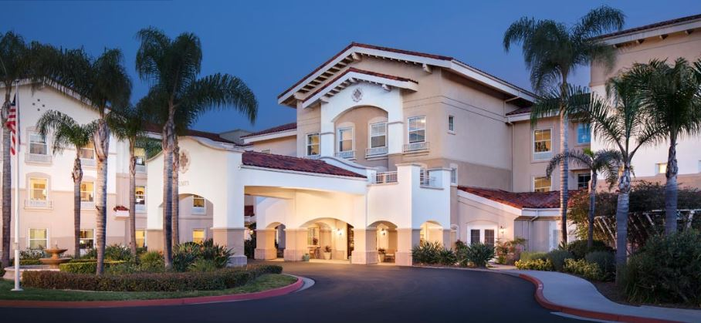
Assisted Living – High End Studios from $4500 1 Bedrooms from $7000 2 Bedrooms from $11,500 *Care Fees are additional, and not included in the above rates

Slide 16
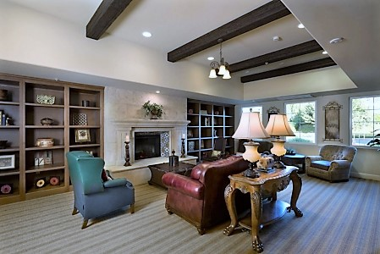
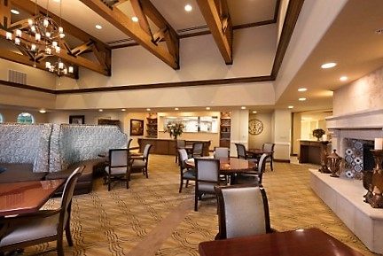
Assisted Living – High End Studios from $4500 1 Bedrooms from $7000 2 Bedrooms from $11,500 *Care Fees are additional, and not included in the above rates

Slide 17
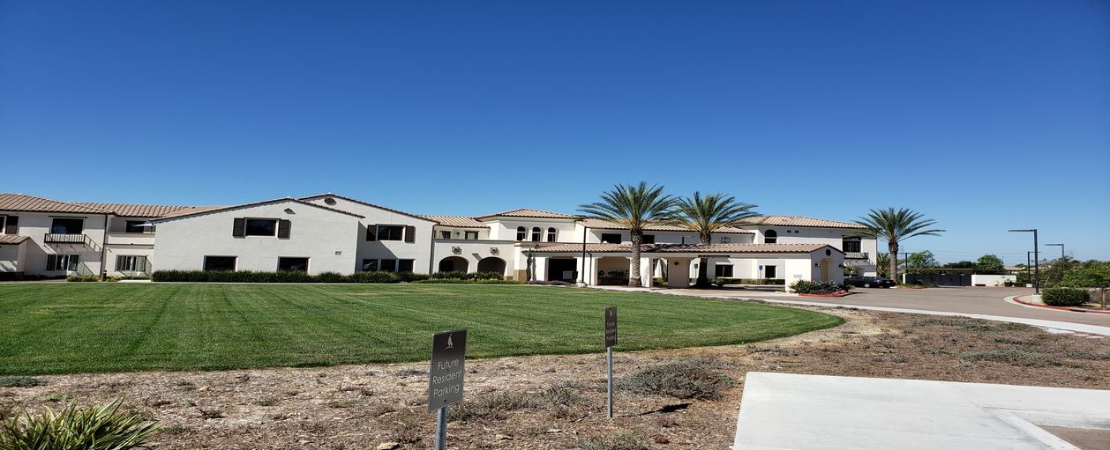
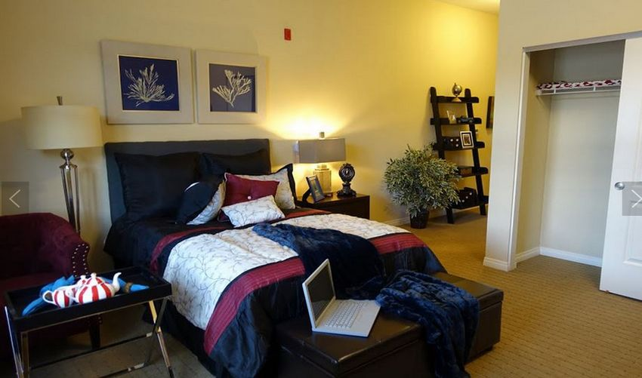
Assisted Living – Moderately Priced Studios from $3500 1 Bedrooms from $4000 *Care Fees are additional, and are not included in the above rates.

Slide 18
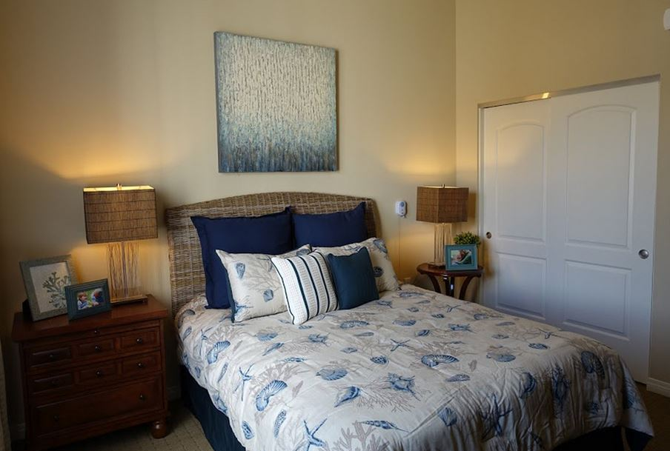
Assisted Living – Moderately Priced Studios from $3500 1 Bedrooms from $4000 *Care Fees are additional, and are not included in the above rates.

Slide 19
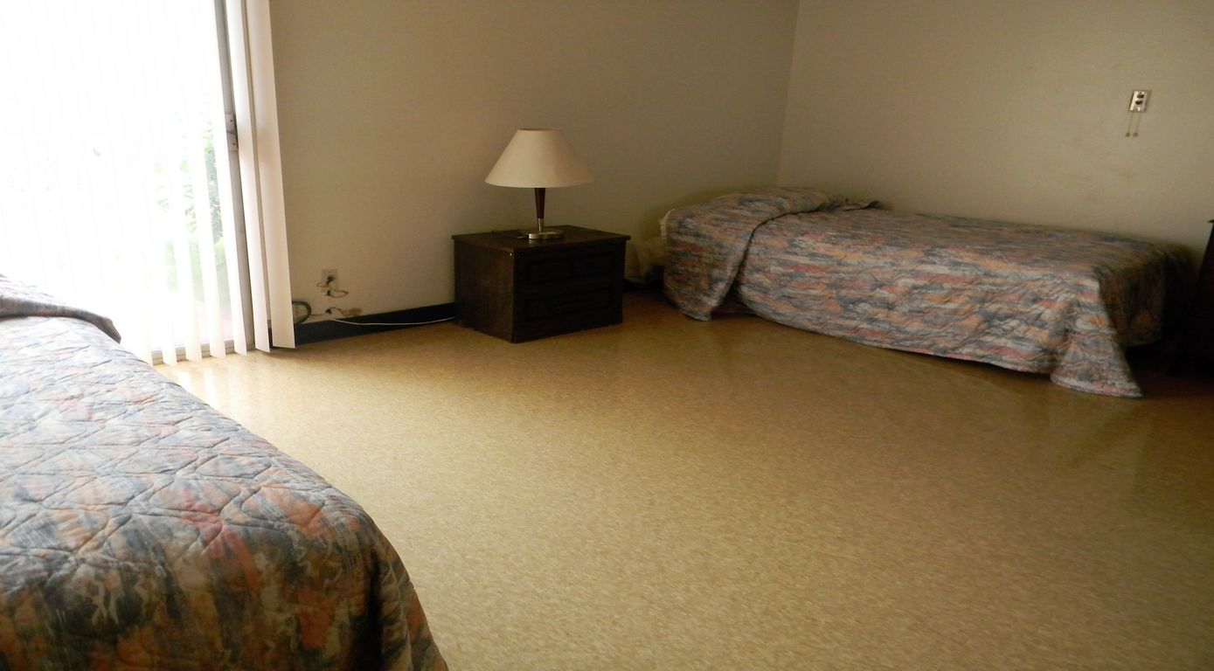
Assisted Living – Low End Private rooms from $2500 Shared rooms from $1800 *Care Fees are additional, and are not included in the above rates.

Slide 20
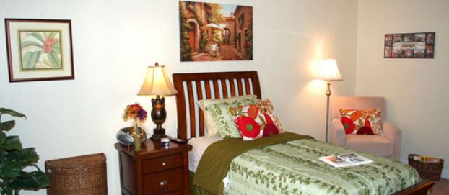
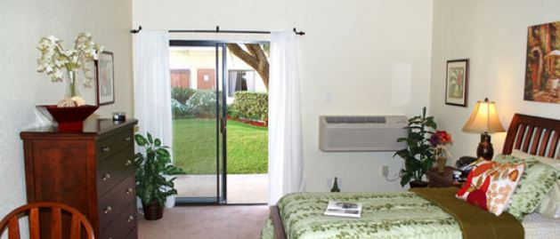
Assisted Living – Low End Private rooms from $2500 Shared rooms from $1800 *Care Fees are additional, and are not included in the above rates.

Slide 21
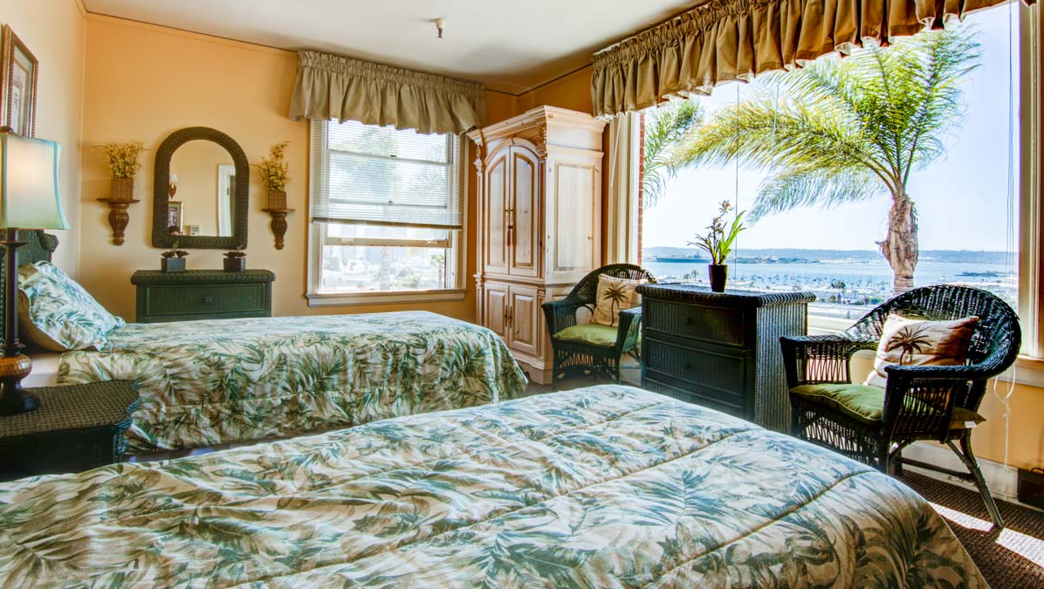
Assisted Living - Alzheimer’s Care Private rooms from $4500 Shared rooms from $3500 *Care Fees are additional, and are not included in the above rates.

Slide 22
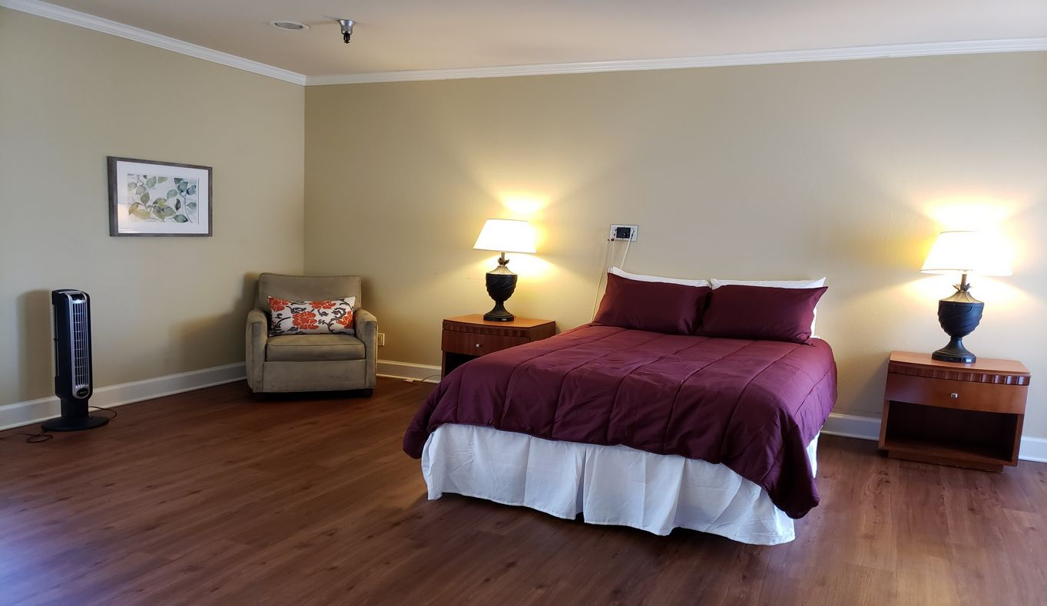
Assisted Living - Alzheimer’s Care Private rooms from $4500 Shared rooms from $3500 *Care Fees are additional, and are not included in the above rates.

Slide 23
Specialty Alzheimer’s/Dementia Care
Specialty Alzheimer’s/Dementia Communities focus their services on those who have more severe Dementia symptoms, and it’s related behaviors such as: agitation, wandering, exit seeking, yelling, sexual behaviors, etc. While they do specialize in behaviors, they will require that aggressive behaviors such as kicking, hitting, biting, and more severe sexual advances be treated with appropriate medications, and their behaviors to be stable prior to admission.
These Communities have a higher staff ratio to provide more one-on-one care than a standard Memory Care Community. Some have Psychiatrists on site, Geriatric Physician’s, and Behavioral Nurses.

Slide 24
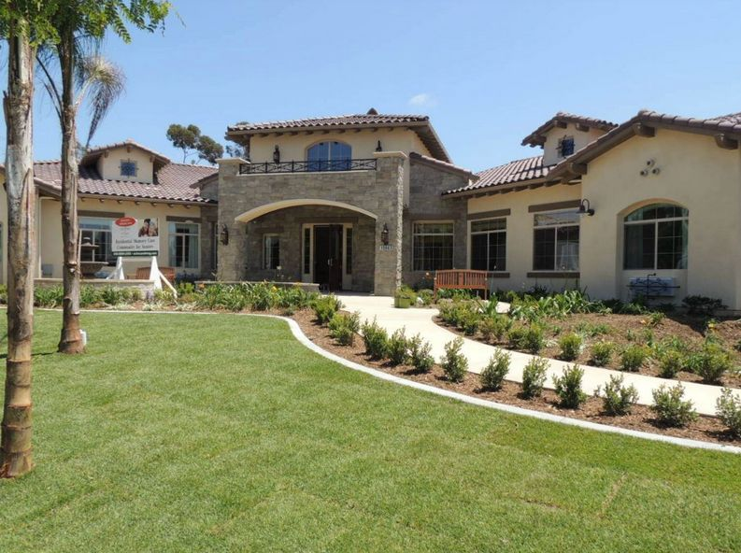
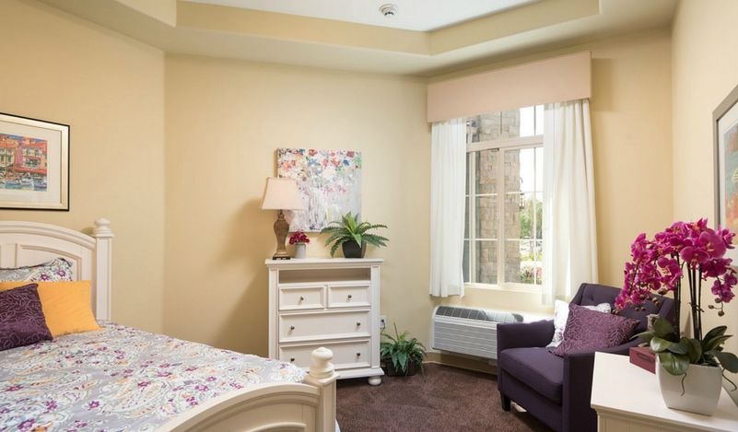
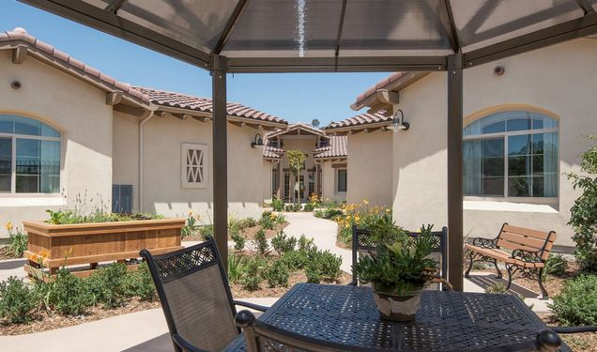
Alzheimer’s Care – Specialty Care Private rooms from $5500 Shared rooms from $5000 *Care Fees are additional, and are not included in the above rates.

Slide 25
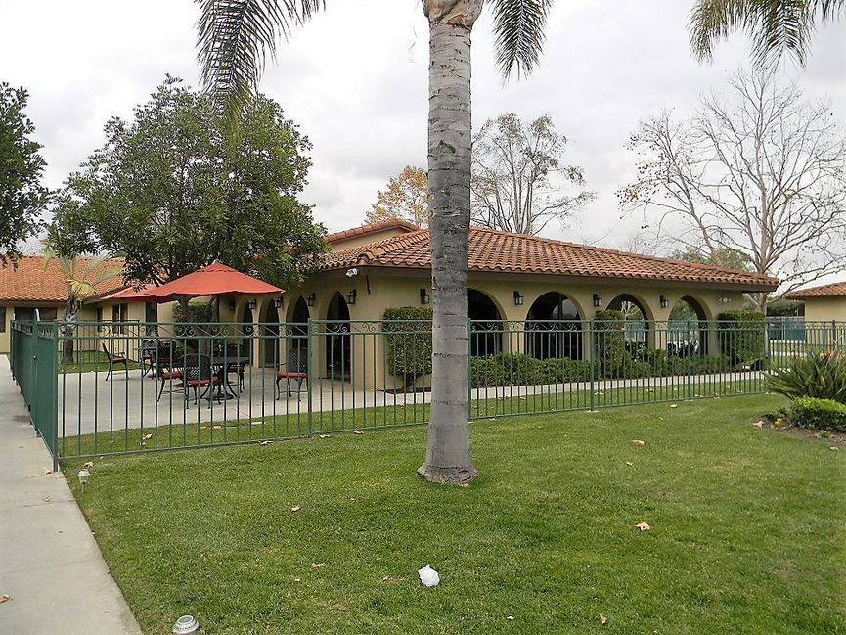
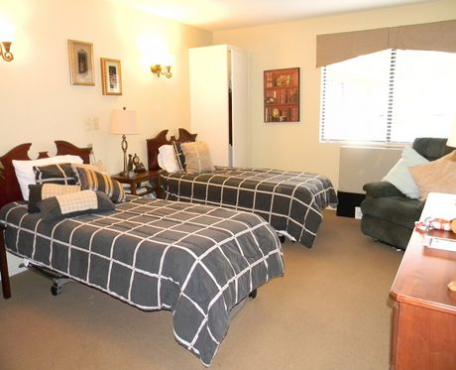
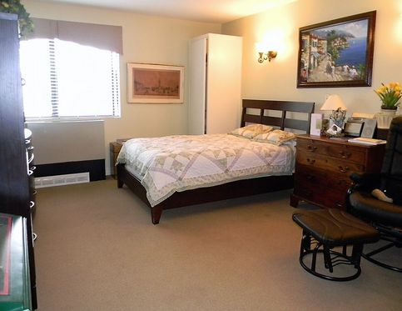
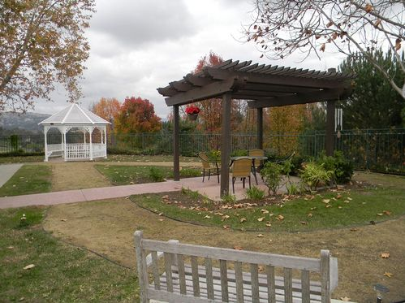
Alzheimer’s Care – Specialty Care Private rooms from $5500 Shared rooms from $5000 *Care Fees are additional, and are not included in the above rates.

Slide 26
Funding
RCFE’s are primarily PRIVATELY FUNDED by the Patient
(Not covered by Medicare or Medi-Cal)
Long-term Care Insurance
Supplemental Security Income (SSI/SSP)
Veteran’s Aid and Attendance Pension Benefit
Family supplementing care costs
Reverse Mortgage, Secured Lines of Credit
Assisted Living Waiver Program (ALW) through Medi-Cal – Currently, this program has a near 2 year waiting list to apply.
*Care Placement does not advise on any legal, financial or personal income tax requirements or issues. We recommend clients speak with a licensed professional for help in determining which financial option is best for them.

Slide 27
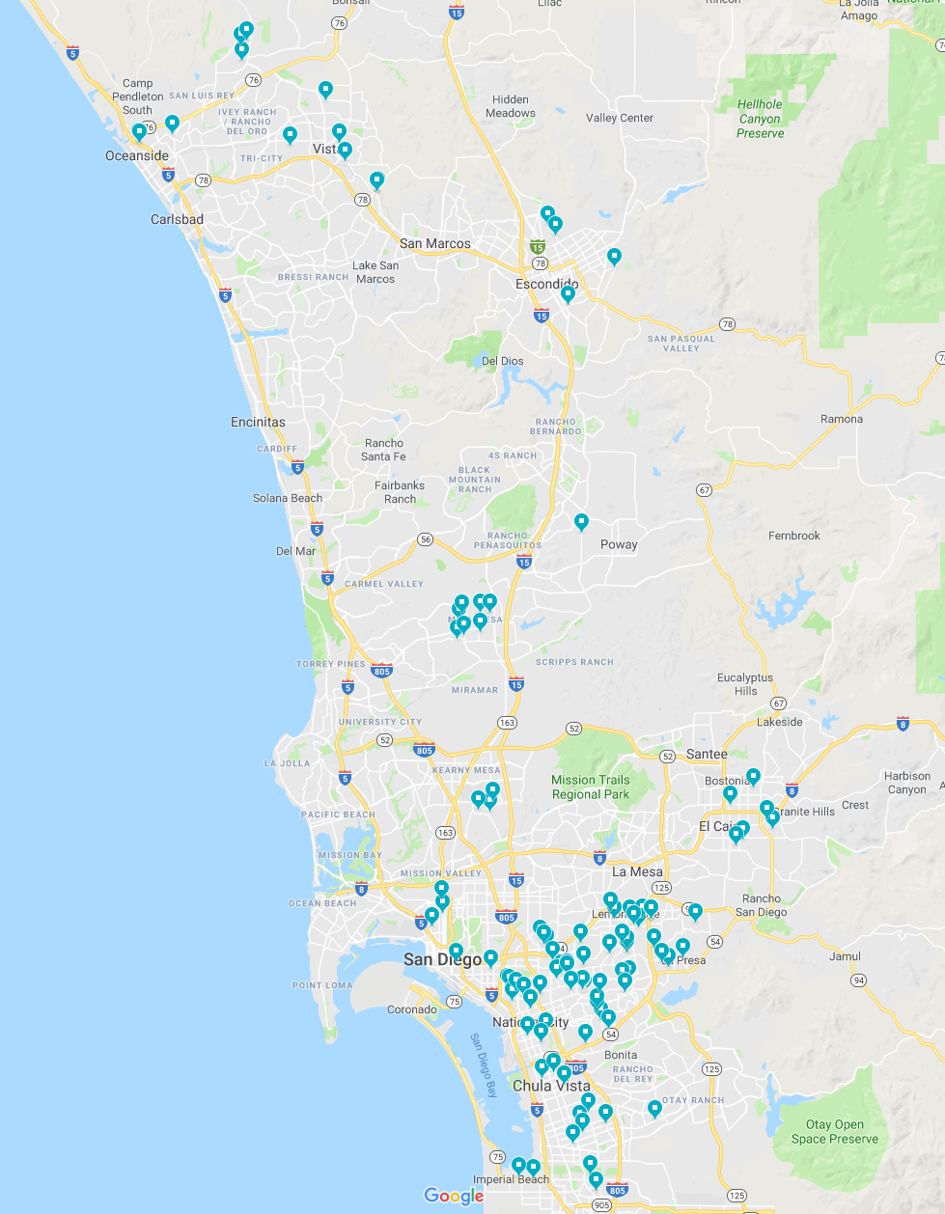
Independent Living Facilities (ILF)
Independent Living Facilities are UNLICENSED. ILFs serve residents that do not need any daily care assistance, supervision, or medication management. There are around 130 ILF homes in San Diego, with many homes closing and opening regularly.
Paid Utilities
Meals provided at some locations. May require an additional monthly fee.
Access to laundry room.
*For Regulations - See California Title 22 - RCFE- 87107 section 4. Which States: The following shall be allowed to operate without being licensed as a residential care facility for the elderly: Any house,
institution, hotel or other similar place that supplies board and room only, or room only, or board only, if no element of care and/or supervision, as defined by this chapter, is provided, made available, or
contractually promised, such as in a life care agreement or program agreement with a facility. However, this shall not preclude care and/or supervision provided for brief and irregular periods of time for
reasons such as temporary illnesses or emergencies provided that such is determined to be minor and temporary and does not require twenty-four (24) hours supervision of the resident(s).

Slide 28
When to contact Care Placement
When it is determined that a patient will be needing care and supervision after discharge, contact Care Placement.
Care Placement will then discuss what options are available to the patient based on their needs, whether it be going home with In Home care assistance, family support, or relocation into an RCFE. We will also review their finances to see what resources are available to the patient and their family. If the patient is discharged to a SNF for rehabilitation, we will follow their progress at the SNF to help aid the patient and their family in planning for the next step.

Slide 29
What is needed prior to discharge?
Physicians Report for RCFE (CDSS LIC602A)
6-page report including ambulatory status, cognitive status, medical history, physical care & social needs.
Medication List – To include current medications, as well as orders for PRN and discontinued medications.
Requires TB test or chest X-ray within past 6 months (PPD can be administered, then confirmed at RCFE within 48 hours of admission)
Must be completed and signed by the Physician.

