Slide 1
When is placement needed?
Dementia/Alzheimer’s behaviors such as Wandering, Exit Seeking, Aggression, etc.
When the patient requires specialized services that must be cared for or monitored by a Nurse
When more than 1 person is needed to care for someone (i.e. transfer assistance, bathing, bariatric, bedridden requiring repositioning)
When the family cannot afford 24 hour services, but their loved one requires 24 hour care and supervision
When the patient would benefit from a Community Setting for socialization and activities
Respite relief for families while there is continued recovery
Hospice (especially for end-of-life care)
Incident Driven situations – such as strokes, hip fractures, etc.
Medication administering

Slide 2
What is an RCFE?
Residential Care Facilities for the Elderly (RCFE) are non-medical facilities that provide around-the-clock care and supervision to residents, ages 60 and above, who need help with activities of daily living (ADL’s).
Activities of Daily Living (ADL’s) - Bathing, dressing, grooming, ambulation, toileting, incontinence, medication management, transportation, meals, laundry, housekeeping, etc.
Amenities – Some RCFE’s offer daily activities, outings, allow for personal pets, can arrange for short-term respite stays, provide furnishings, have religious services, etc.
Specialized Services – Only some RCFE’s can provide care for: Wander Risks, Exit-Seekers, Sundowner’s, Catheters, Ostomies, Two-Person Transfers / Hoyer Lift, Bariatric, Insulin Injections, Special Diets, Bedridden, Feeding Tubes, Hospice, etc.

Slide 3
What types of RCFE’s are available?
Residential Care Facilities - Also known as “Board and Care”. 1-15 beds. Staff Ratio of 1-3 caregivers to 6 residents.
Assisted Living Communities - 16+ beds. Staff Ratio of 1 caregiver to 10-15 residents.
Alzheimer’s/Dementia Care - Also known as “Memory Care”. Behaviors must be stabilized. Secured for wanderers and some exit seeking.
Specialty Alzheimer’s/Dementia Care - For those with behaviors, or those who need a secured environment for severe exit seeking.

Slide 4
Cost of RCFE vs. In Home Services
Average In Home Care cost - $28.50/hour
Average Total Cost for 24 Hour Care - $20,520/month
Average RCFE cost - $5000 - $6000/month
For heavier needs like, Bedridden (with repositioning every 2 hours), multiple Diabetic Injections, Ostomies, Feeding Tubes, wound care, bariatric, or 24 Hour Awake Staff the rate will average between $6000 - $8000/month*
*Rates all vary based on the area.
*Care Placement does not advise on any legal, financial or personal income tax requirements or issues. We recommend clients speak with a licensed professional for help in determining which financial option is best for them.

Slide 5
Funding
RCFE’s are primarily PRIVATELY FUNDED by the Patient
(Not covered by Medicare or Medi-Cal)
Long-term Care Insurance
Supplemental Security Income (SSI/SSP)
Veteran’s Aid and Attendance Pension Benefit
Family supplementing care costs
Reverse Mortgage, Secured Lines of Credit
Assisted Living Waiver Program (ALW) through Medi-Cal – Currently, this program has a near 2 year waiting list to apply.
*Care Placement does not advise on any legal, financial or personal income tax requirements or issues. We recommend clients speak with a licensed professional for help in determining which financial option is best for them.

Slide 6
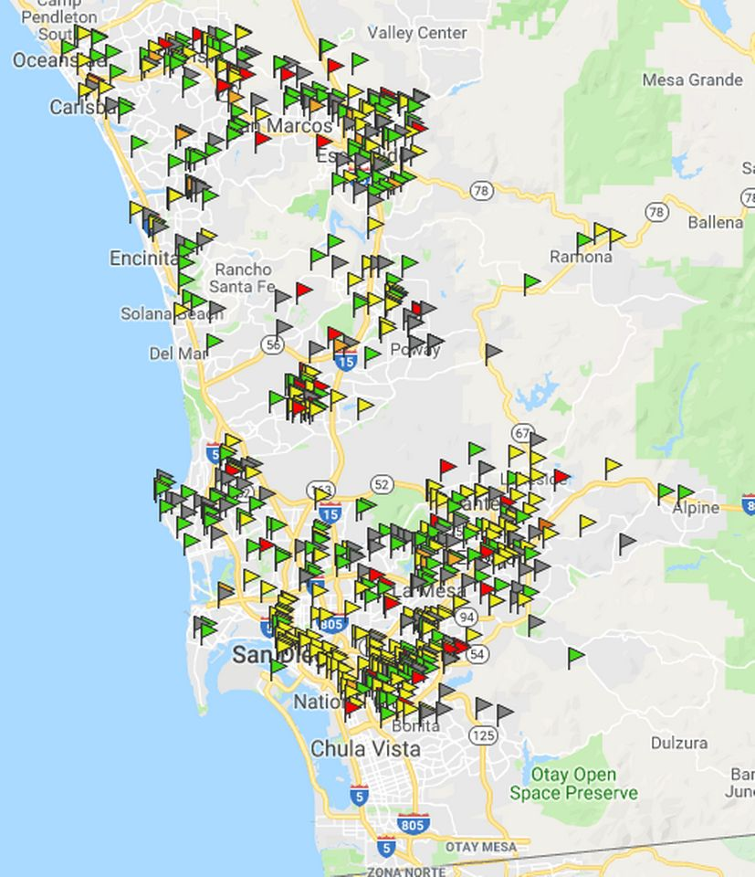
San Diego RCFEs
19,610 RCFE beds in 588 facilities
12,511 Assisted Living beds (119)
2,834 Board & Care beds (458)
1,195 beds in 21 RCFEs Pending Licensure
5,505 Alzheimer's/MC beds in 57 facilities
399 RCFEs have Hospice Waivers (59%)
Avg. Hospice Rate = $120
(as of 1/1/19)

Slide 7
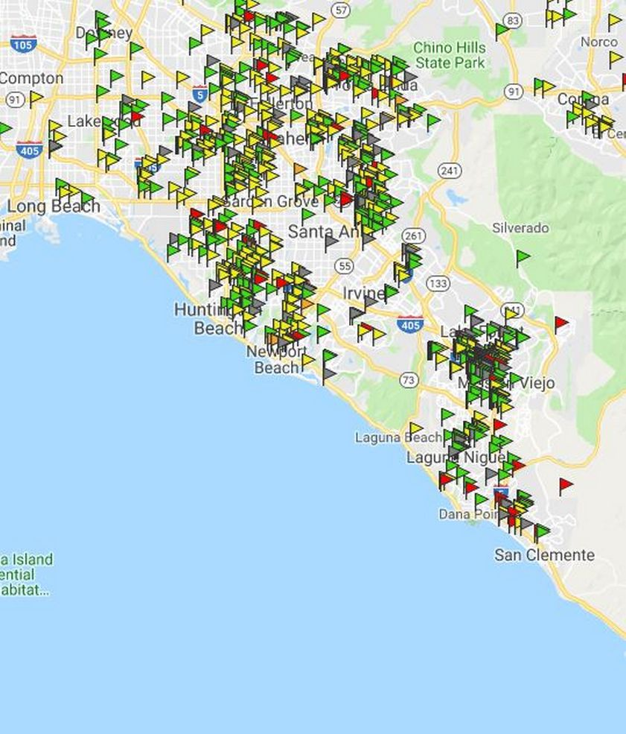
Orange County RCFEs
20,447 RCFE beds
in 947 facilities
12,076 Assisted Living beds (95)
5,031 Board & Care beds (841)
5,422 Alzheimer's/Memory Care beds in 51 facilities
5,368 Assisted Living MC beds (42)
54 Board & Care MC beds (9)
614 RCFEs have Hospice Waivers (66%)
Approx. 65 Hospice Beds Now Available in 55 RCFEs
Avg. Hospice Rate = $120
(as of 1/1/19)

Slide 8
Our Mobile Database App
Homes Database - With nearly 2,000 homes in San Diego and Orange County, we track all licensed RCFE’s and regularly check Community Care Licensing to keep up-to-date on all pending locations, as well as those that have closed, or changed ownership. We also monitor their Complaints and Deficiencies with licensing so that we know which homes are having neglect issues, and which homes have a clean standing with licensing.
Mobile App - At the patient’s bedside, we are able to help families locate care homes in their preferred area. The app has pictures of each RCFE as well as notes from our personal visits, and family testimonials.

Slide 9
Title 22 Restricted Health Conditions
The following are allowed if self-managed by the resident OR administered by an Appropriately Skilled Professional, such as, a Registered Nurse:
Oxygen (Gas / Liquid)
Catheter (staff can only empty the bag of it’s contents)
Colostomy/Ileostomy (staff can only empty the bag of it’s contents)
Fecal Impaction Removal, Enemas and/or Suppositories
Contractures
Injections
Intermittent Positive Pressure Breathing (IPPB) Machine
Stage 1 & 2 Pressures Sores

Slide 10
Title 22 Prohibited Health Conditions
New Allowances in RCFE, some with Restrictions
Stage 3 & 4 Pressure Sores (Prohibited, unless on Hospice)
Communicable Infections – Staph, CDIFF, MRSA, etc. (Prohibited, unless colonized)
G-Tube, PEG, NG-Tube, IV’s (Some allowances on Hospice, or if in a home with 24-hour Nursing)
Bedridden (Requires Fire Clearance)
Wound VAC
Psych/Mental Illness as a primary diagnosis (Must not have any behaviors that would disturb other residents.)

Slide 11
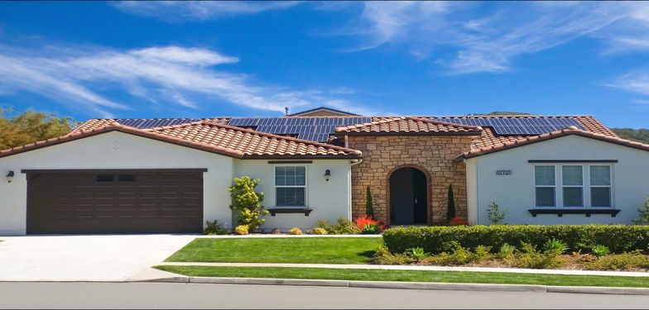
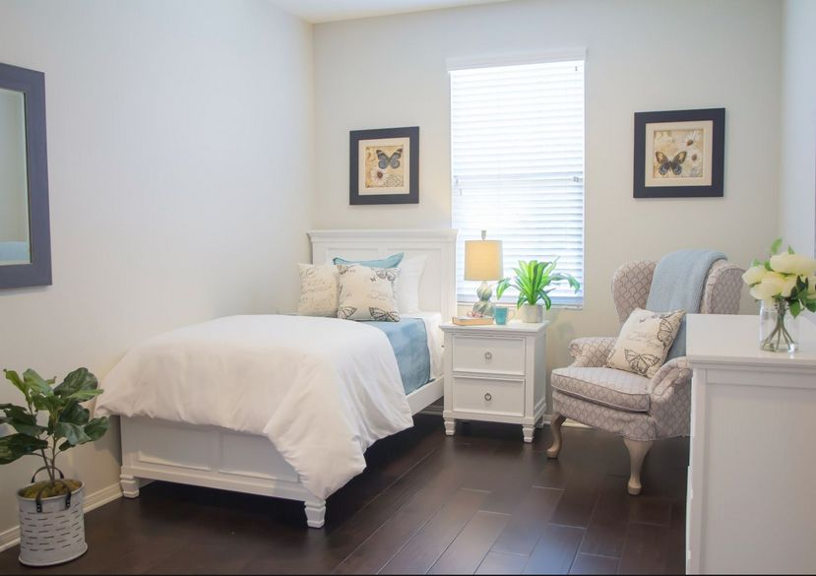
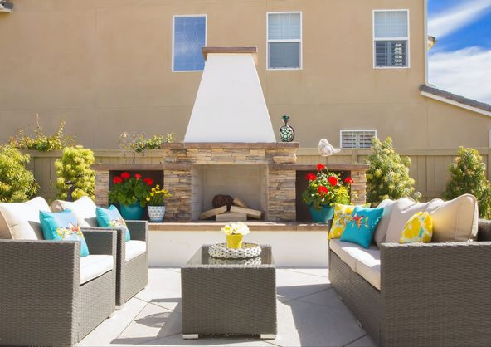
Residential Care Home
High End
Private rooms from $6500 Shared rooms from $5000

Slide 12
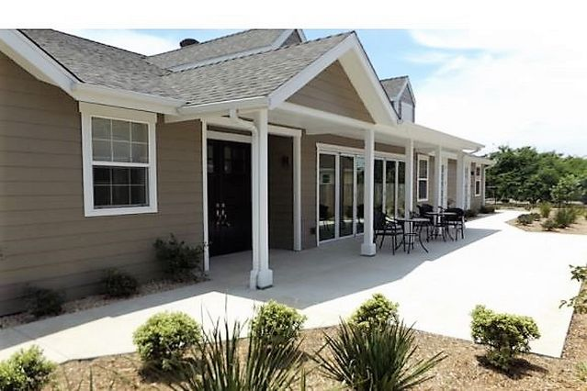
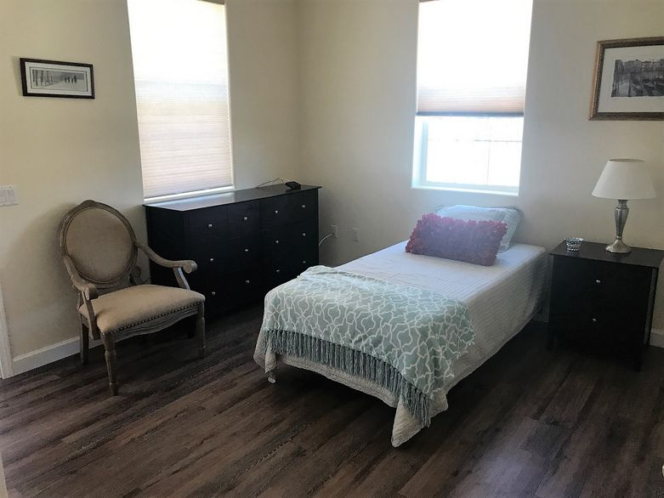
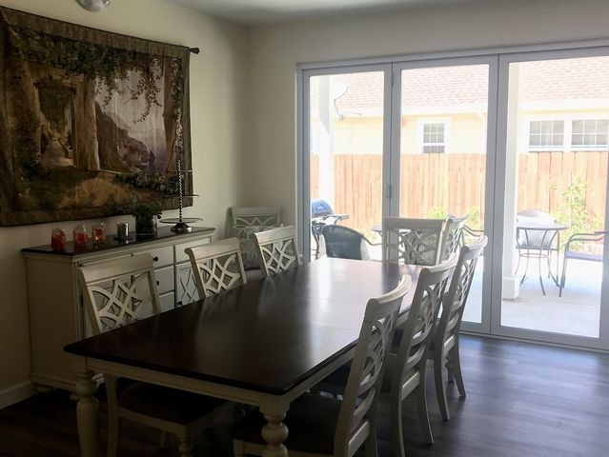
Residential Care Home
High End
Private rooms from $6500 Shared rooms from $5000

Slide 13
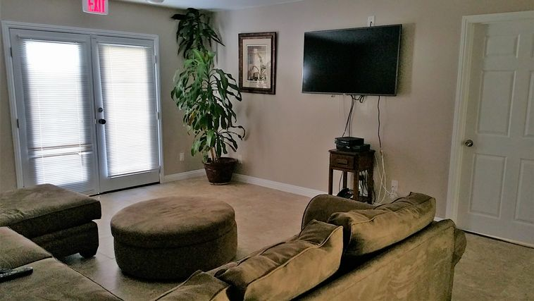
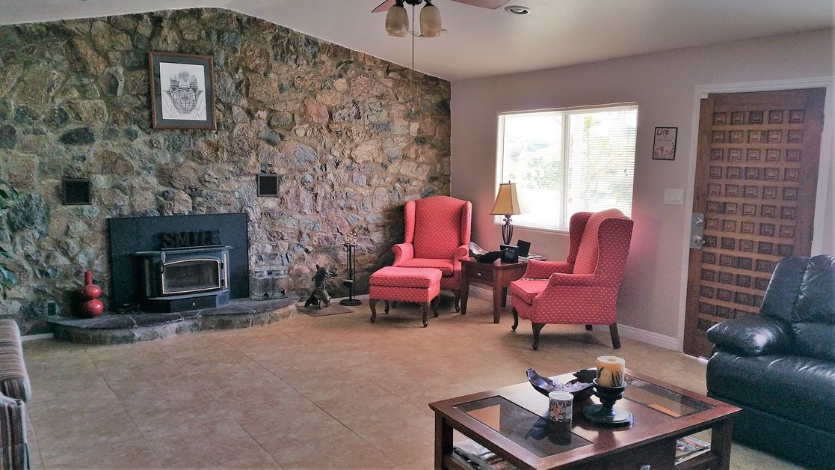
Residential Care Home
Moderately Priced
Private Rooms from $5000
Shared Rooms from $4000

Slide 14
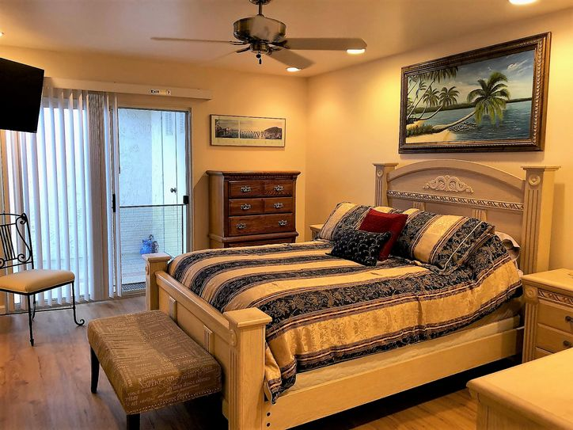
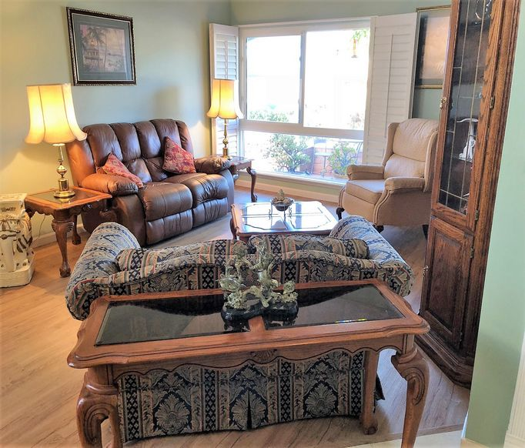
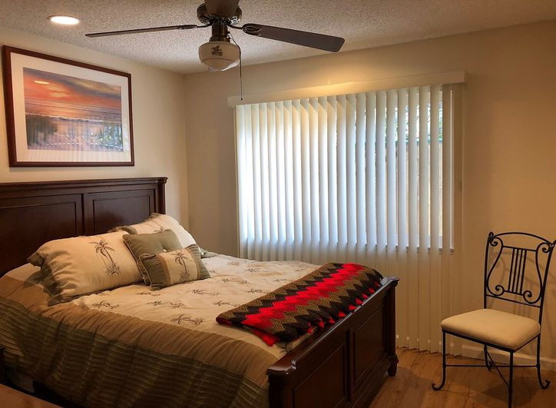
Residential Care Home
Moderately Priced
Private Rooms from $5000
Shared Rooms from $4000

Slide 15
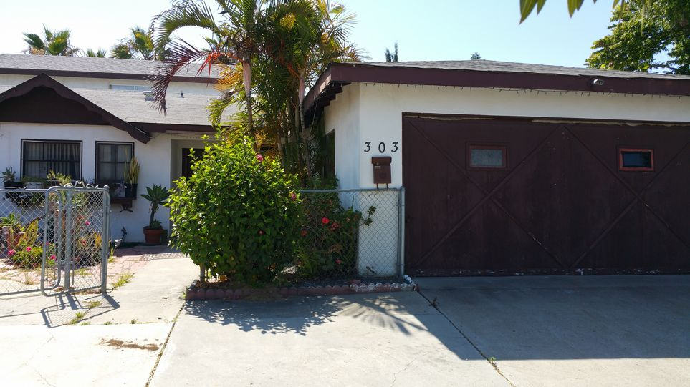
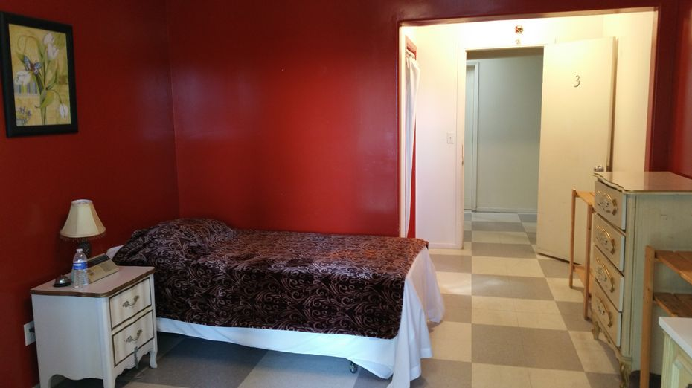
Residential Care Home
Low Cost
Private rooms from $3000
Shared rooms from $1800

Slide 16
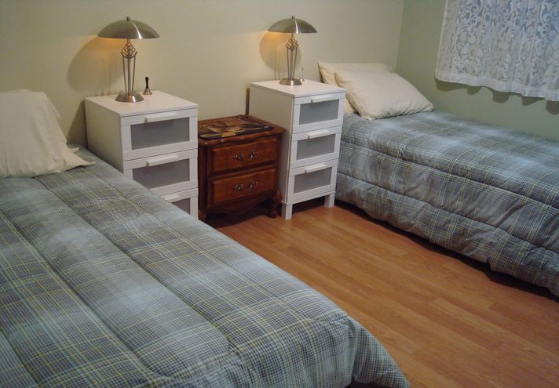
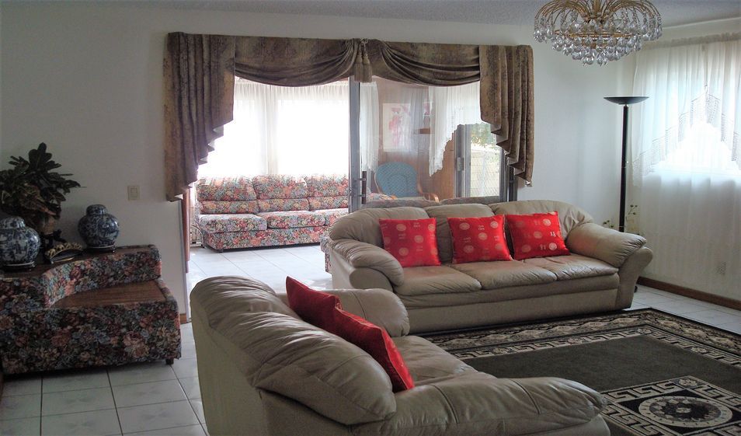
Residential Care Home
Low Cost
Private rooms from
$3000
Shared rooms from $1800

Slide 17
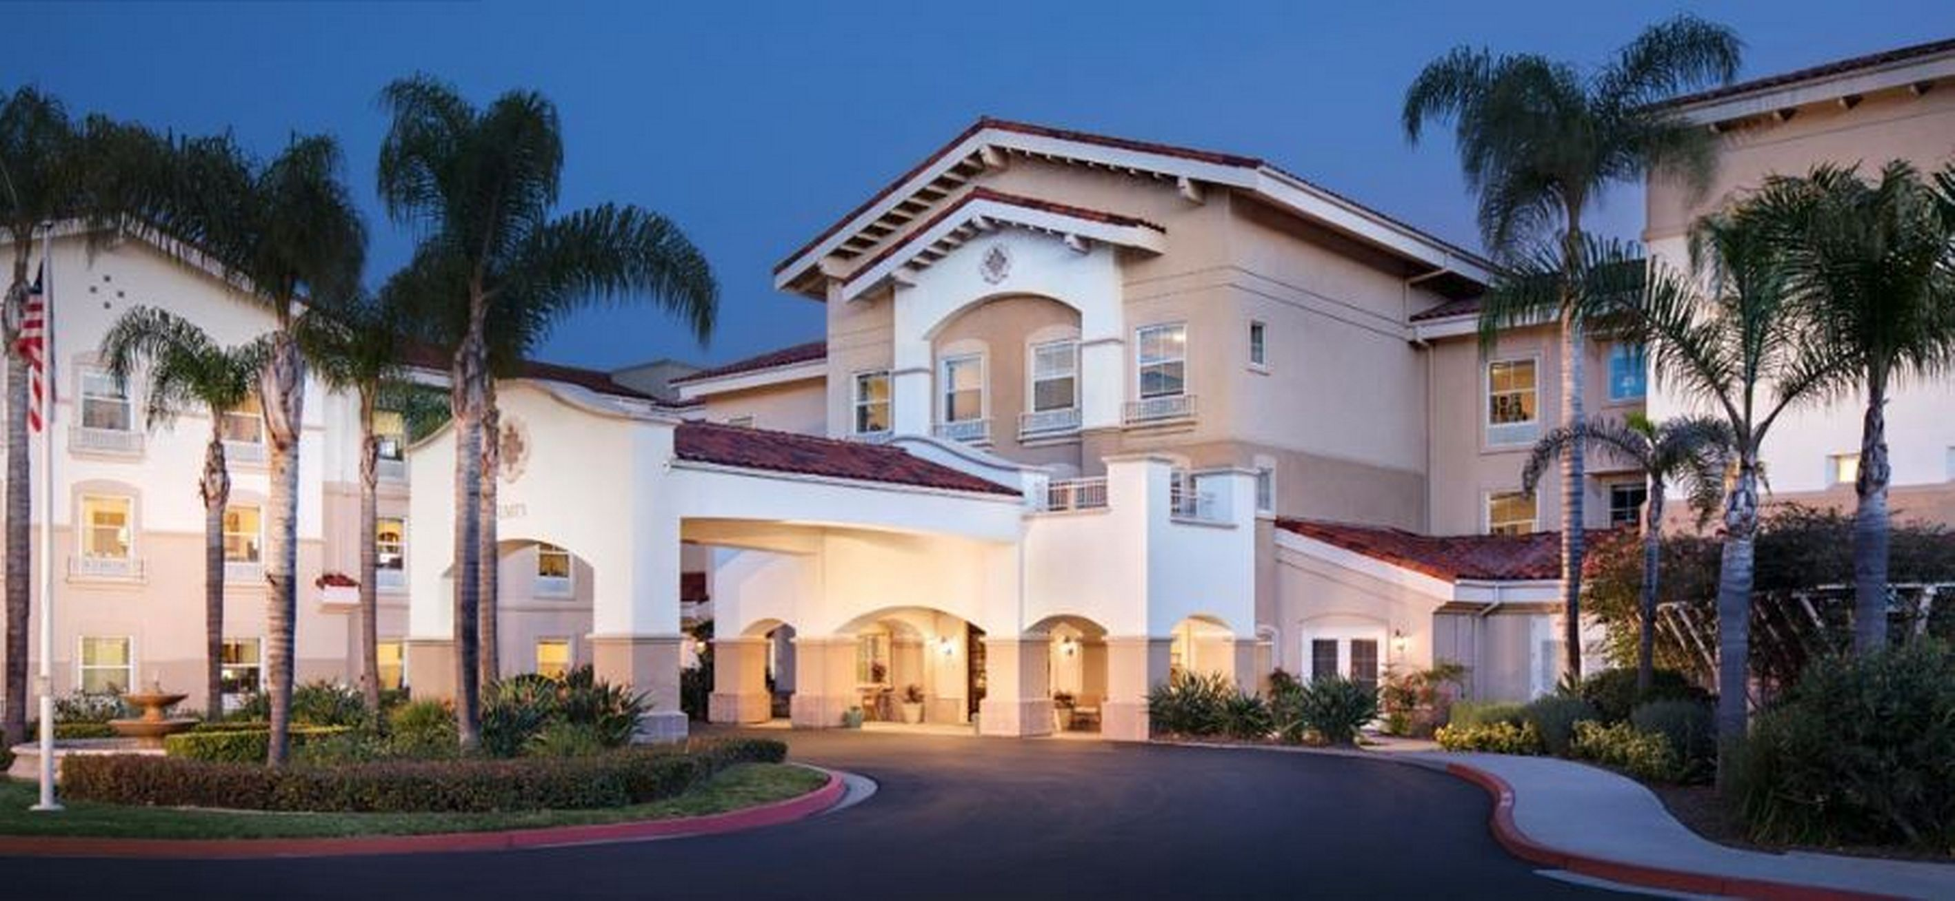
Assisted Living – High End Studios from $4500 1 Bedrooms from $7000 2 Bedrooms from $11,500 *Care Fees are additional, and not included in the above rates

Slide 18
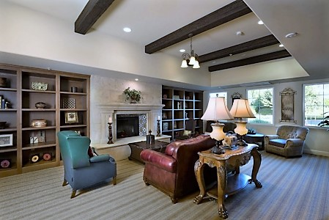
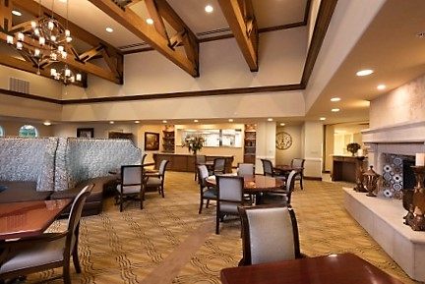
Assisted Living – High End Studios from $4500 1 Bedrooms from $7000 2 Bedrooms from $11,500 *Care Fees are additional, and not included in the above rates

Slide 19
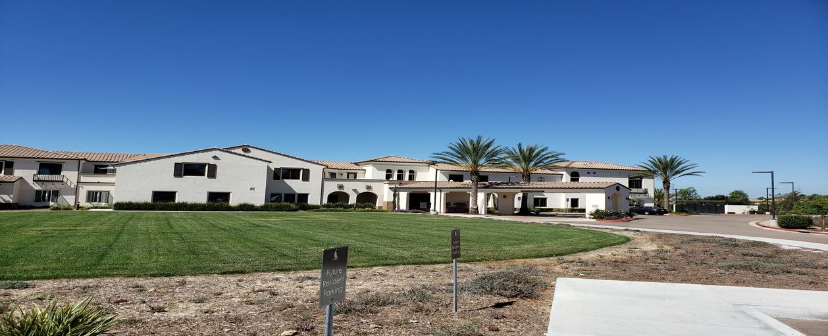
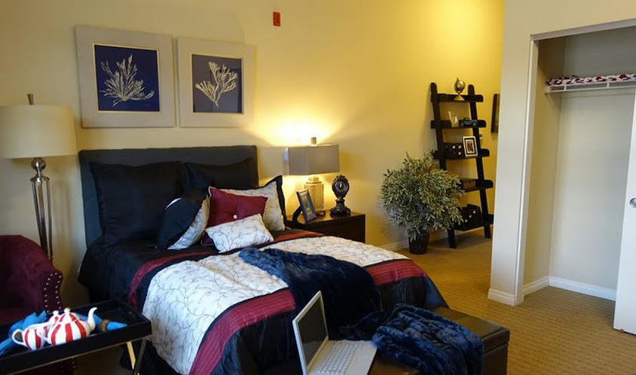
Assisted Living – Moderately Priced Studios from $3500 1 Bedrooms from $4000 *Care Fees are additional, and are not included in the above rates.

Slide 20
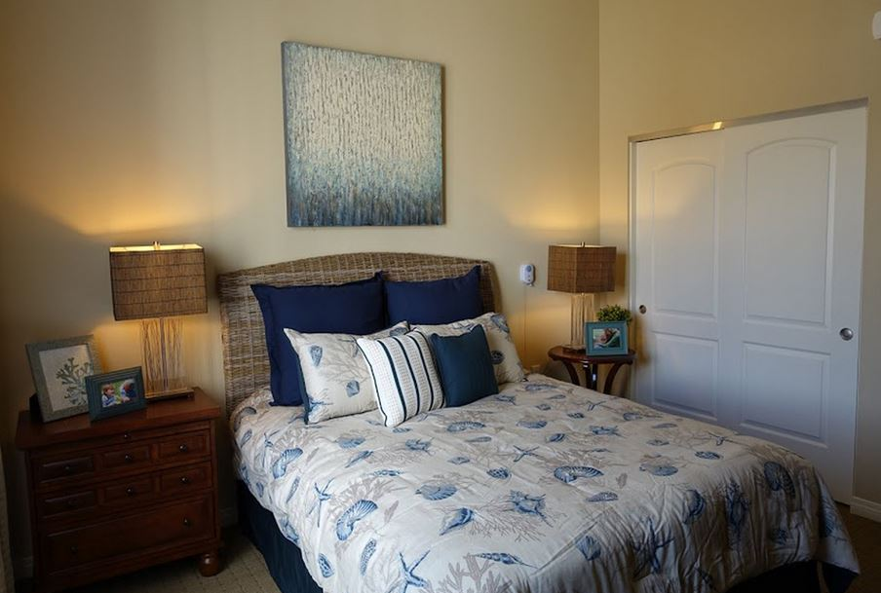
Assisted Living – Moderately Priced Studios from $3500 1 Bedrooms from $4000 *Care Fees are additional, and are not included in the above rates.

Slide 21
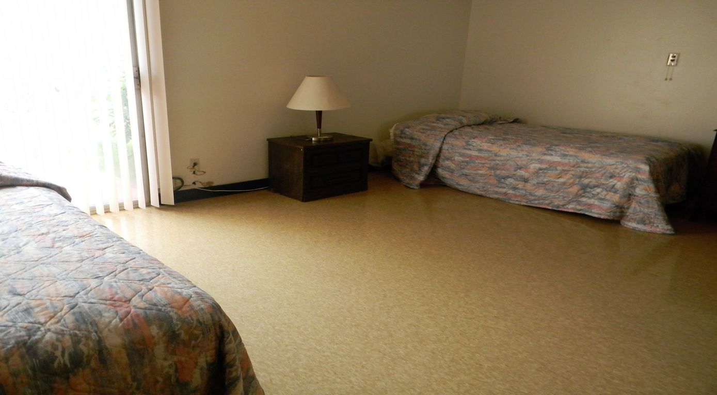
Assisted Living – Low End Private rooms from $2500 Shared rooms from $1800 *Care Fees are additional, and are not included in the above rates.

Slide 22
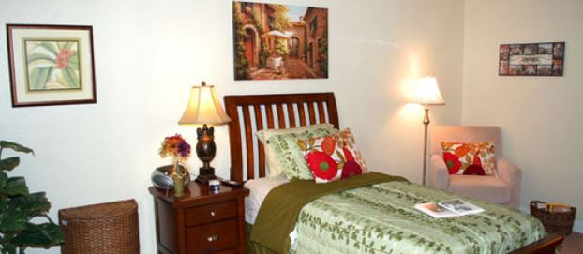
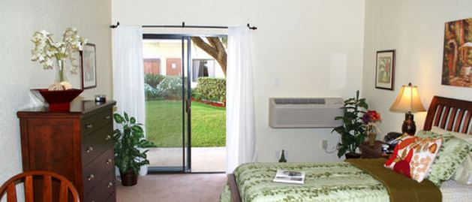
Assisted Living – Low End Private rooms from $2500 Shared rooms from $1800 *Care Fees are additional, and are not included in the above rates.

Slide 23
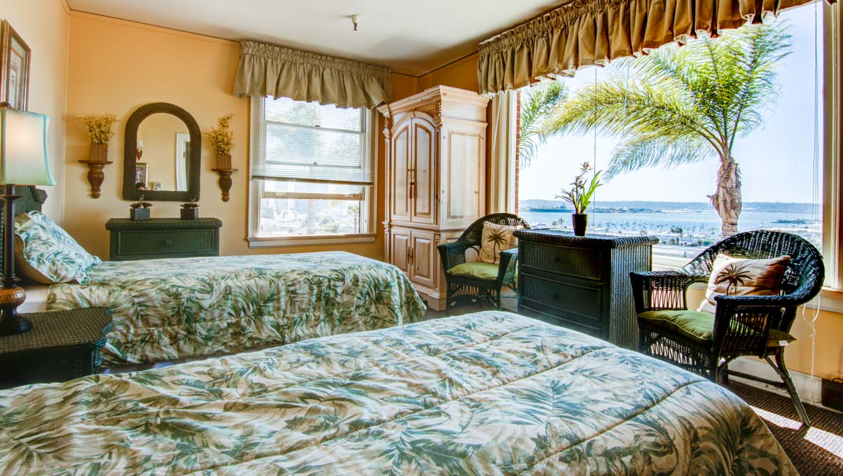
Assisted Living - Alzheimer’s Care Private rooms from $4500 Shared rooms from $3500 *Care Fees are additional, and are not included in the above rates.

Slide 24
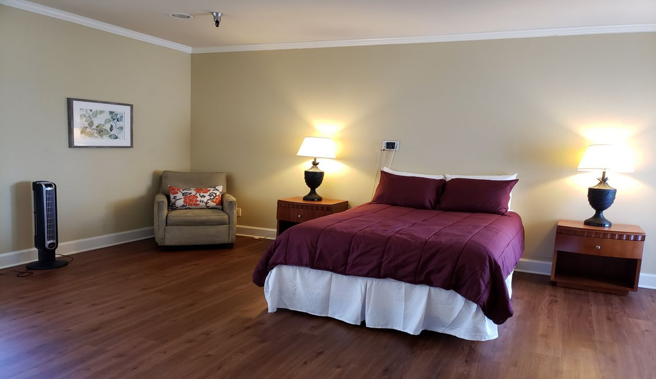
Assisted Living - Alzheimer’s Care Private rooms from $4500 Shared rooms from $3500 *Care Fees are additional, and are not included in the above rates.

Slide 25
Specialty Alzheimer’s/Dementia Care
Specialty Alzheimer’s/Dementia Communities focus their services on those who have more severe Dementia symptoms, and it’s related behaviors such as: agitation, wandering, exit seeking, yelling, sexual behaviors, etc. While they do specialize in behaviors, they will require that aggressive behaviors such as kicking, hitting, biting, and more severe sexual advances be treated with appropriate medications, and their behaviors to be stable prior to admission.
These Communities have a higher staff ratio to provide more one-on-one care than a standard Memory Care Community. Some have Psychiatrists on site, Geriatric Physician’s, and Behavioral Nurses.

Slide 26
When to contact Care Placement
When staying at home is no longer appropriate for the patient and family…
Care Placement will then discuss what options are available to the patient and their family based on their needs. We will also review their finances to see what resources are available to them. With almost 600 RCFEs in San Diego, it can be overwhelming for a family to narrow down their options. Care Placement has a team who specialize in knowing the care homes and communities, and can help narrow down what options are a fit for the family based on the care needs, area, budget, and special requests (likes to garden, has a cat to bring, etc.).

