Slide 1
How We Can Help You
The purpose of this In-Service is to inform you of exactly how Care Placement can benefit you and your patients.

Slide 2
Our Role
Care Placement will…
Do a full assessment of Patient’s social, financial and care needs
Explain funding - Medi-Cal/Medicare, VA Aid & Attendance, ALWP, PACE, etc.
Explain options and provide elder care resources
Provide a list of 3-5, pre-qualified, licensed Residential Care Facilities for the Elderly (RCFE)
Guide the family through the process of choosing an RCFE
Coordinate with Patient / Family and RCFE Administrators
Confirm and review required documentation
Follow through after placement to ensure quality of care

Slide 3
We Know The Providers
We visit the homes and communities, sample the food and rate them internally
We closely track feedback from over 1,700 clients
Close monitoring of the state licensing page for citations
Homes with records of poor care or neglect are not referred to
All staff are certified RCFE administrators
Largest Local Referral Agency
Assisted approximately 30,000 families since 2000

Slide 4
Less Hospital Readmissions
Placement into care homes that are qualified to provide the necessary level of care for each patient means fewer hospital readmissions.

Slide 5
Immediate Discharge
Able to assist with discharge into appropriate care homes in a matter of hours
Staff on call nights and weekends to help whenever needed
We keep in constant contact with the care home, and family, to ensure a smooth transition
We follow up with the family within two days after placement to ensure quality of care

Slide 6
Mobile Database App
Dedicated Database of all Patients
Stores all patient history, referral options provided, every contact with the family, and current status
Care Placement Mobile App
At the patient’s bedside, we are able to help families locate care homes in their preferred area. The app has pictures of each RCFE as well as notes from our personal visits, and family testimonials

Slide 7
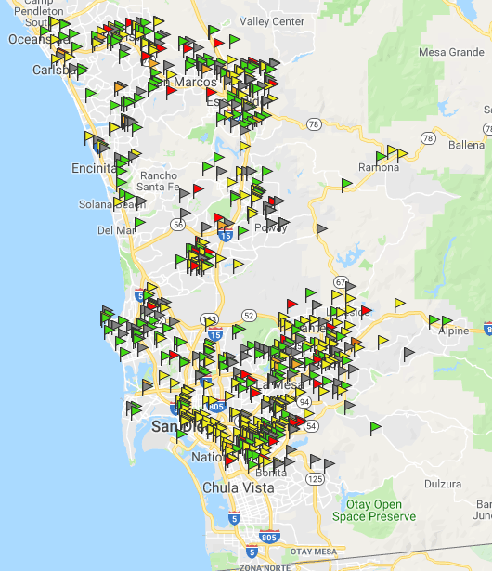
San Diego RCFEs
19,610 RCFE beds in 588 facilities
12,511 Assisted Living beds (119)
2,834 Board & Care beds (458)
1,195 beds in 21 RCFEs Pending Licensure
5,505 Alzheimer's/MC beds in 57 facilities
399 RCFEs have Hospice Waivers (59%)
Avg. Hospice Rate = $120
(as of 1/1/19)

Slide 8
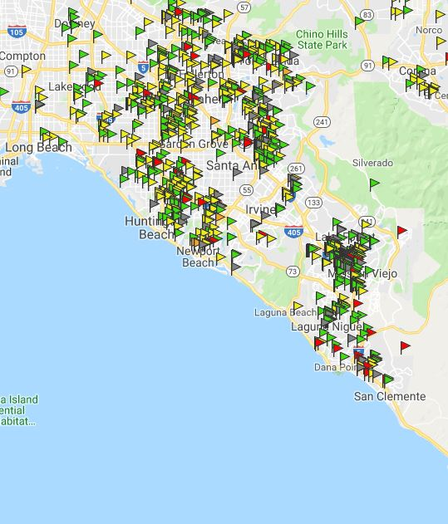
Orange County RCFEs
20,447 RCFE beds in 947 facilities
12,076 Assisted Living beds (95)
5,031 Board & Care beds (841)
5,422 Alzheimer's/Memory Care beds in 51 facilities
5,368 Assisted Living MC beds (42)
54 Board & Care MC beds (9)
614 RCFEs have Hospice Waivers (66%)
Approx. 65 Hospice Beds Now Available in 55 RCFEs
Avg. Hospice Rate = $120
(as of 1/1/19)

Slide 9
***Web Portal
www.careplacement.com/***
Web Portal Features
Independent Living list of available rooms in San Diego County
Board & Care (RFCE) Readmission Checklist
Assisted Living Waiver (ALW) Pre-screen Form
6 Page Physician’s Report download (Required prior to placement into any RCFE)

